Slide 1
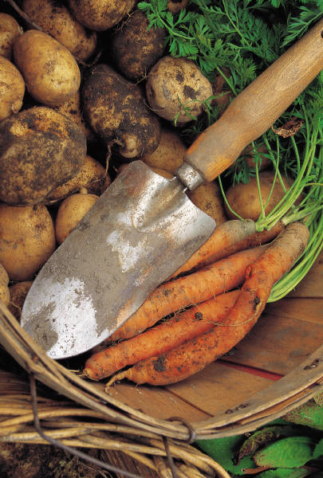
Food Safety for Garden to Cafeteria
County of San Diego
Food and Housing Division
Stephanie Singleton LeAnh Irish

Slide 2
How Can Produce Become Infected with Pathogens?
Pre-Harvest
Soil
Irrigation Water
Improperly Composted Manure
Air (dust)
Animals
Human Handling
Water for Other Uses
Post-Harvest
Human Handling
Harvesting Equipment
Transport Containers
Animals
Wash and Rinse Water
Improper storage
Improper Handling When Being Prepared
Source: FDA-Safe Practices for Food Processes

Slide 3
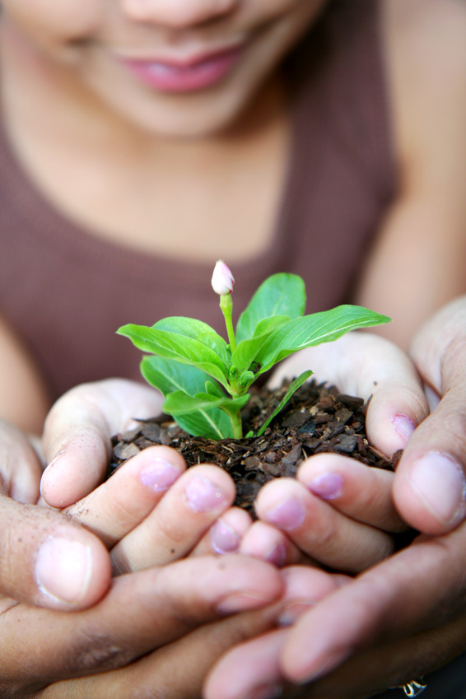
Pre-Harvest Risk Factors
Soil
Gardens are not allowed on a leach field.
Ensure soil is free of pathogens and other contaminants.
Water
Potable water source that is free of pathogens.
Graywater and recycled water are not allowed.
Ensure water runoff from other sources are not running into the garden.

Slide 4
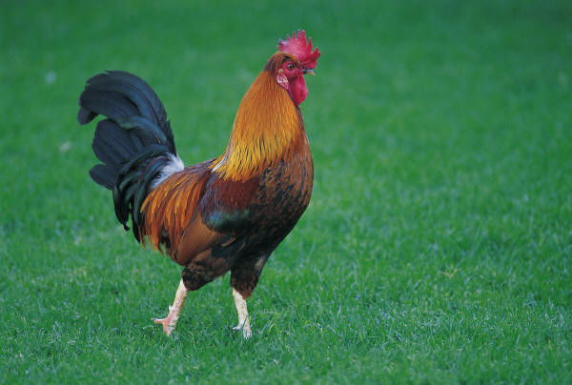
Pre-Harvest Risk Factors
Composted Manure
Commercially processed compost that has been approved for use in vegetable gardens. Improperly composted manure can result in food-borne illnesses. Composted manure use will not be permitted.
Animals
Excluded from the garden. Animals can spread pathogens to the soil or to the produce directly from their fecal material and from their movement through the garden. Ensure animals are also excluded from the water source and from contaminating any other equipment used for the garden.
Animal by-products cannot be used in the school cafeteria.

Slide 5
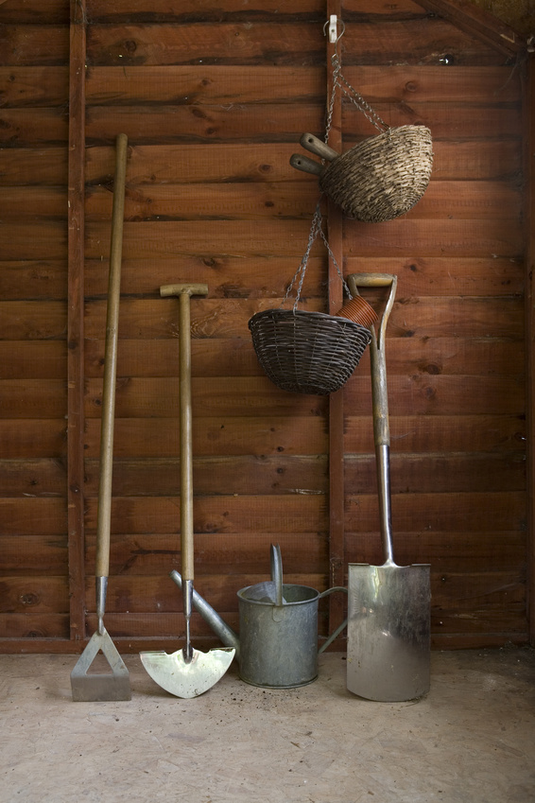
Post-Harvest Risk Factors
Human Handling
Hands are washed prior to handling produce.
Students that have open cuts/wounds on exposed skin should not be allowed to work in the garden
Harvesting Equipment
Stored in area to prevent contamination. Used only for produce gardens.
Transport Containers
Clean and sanitized between uses, no excess food debris.
Notes:
The produce grown in the garden is considered ready-to-eat.

Slide 6
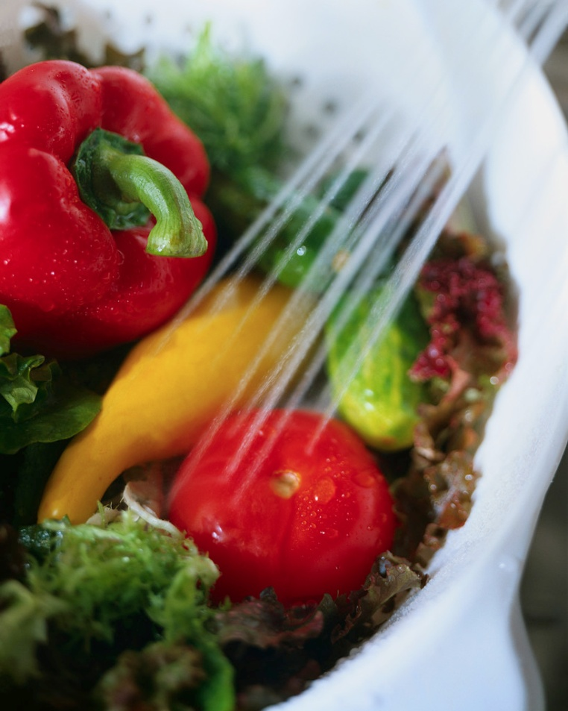
Post-Harvest Risk Factors
Animals
Excluded from the garden. Any produce that has been eaten by or otherwise contaminated by animals/insects should be discarded.
Wash and Rinse Water
Ensure a potable water source is used to clean the produce.
Soap and dish detergents are not approved to wash produce.
Rotten fruit should be discarded.
Improper Storage
Improper Handling When Being Prepared

Slide 7
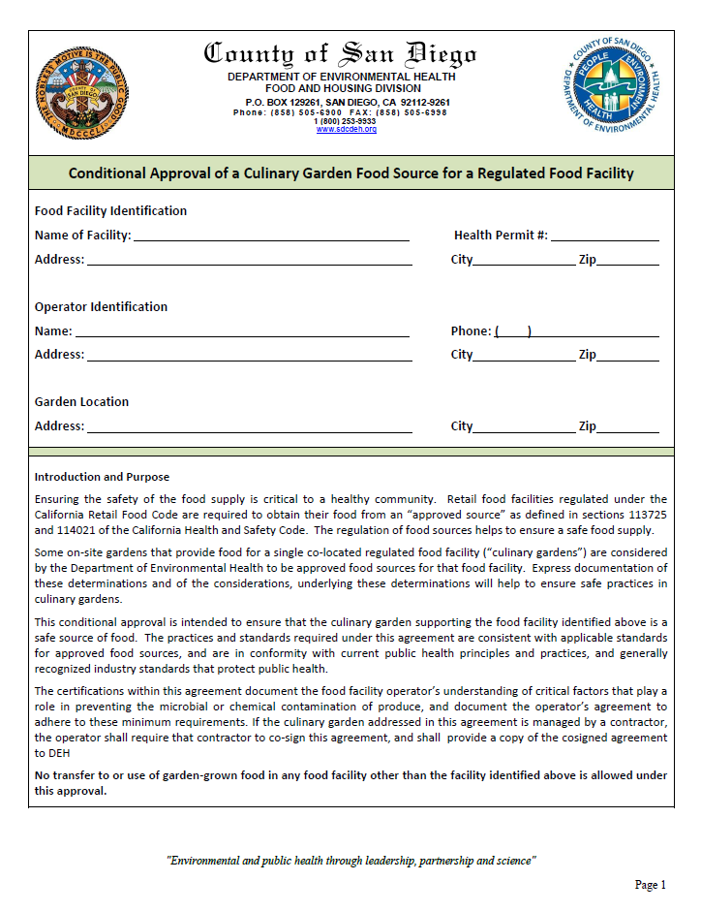
Registering the Garden
Schools are permitted to have a garden on site and use the produce in the school cafeteria. Our department’s goal is to ensure all produce is grown, harvested and processed in a safe and healthy manner.
Simple registration process:
Fill out conditional agreement.
Submit the agreement to our department for approval.
Keep the approved agreement at the school for specialists to review during inspection.
The garden will be covered under the school cafeteria’s health permit. No additional permit fees are required.
Produce grown at the garden can not be sold to the public or used at other locations other than the identified cafeteria.

Slide 8
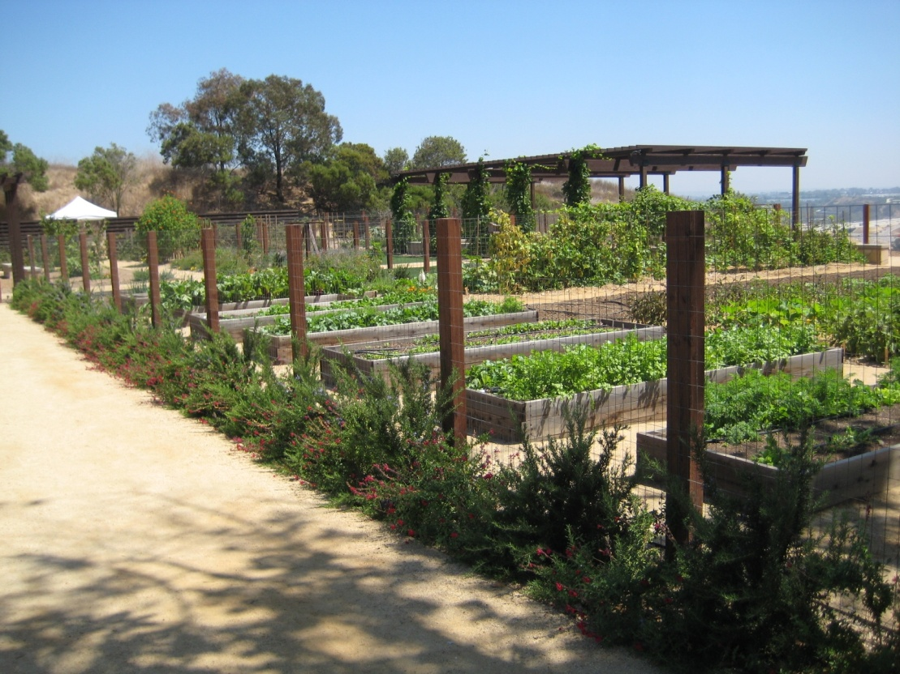
Inspection Process
The school garden will be inspected at the same time the school cafeteria is inspected. Specialists will review the approved agreement that the school must keep on site and ensure that the agreement is being followed.
There are restrictions for what can be served in the school cafeteria:
Seed Sprouts are not allowed
All juice must be pasteurized. Schools are not allowed to make their own juice to serve to students.

Slide 9
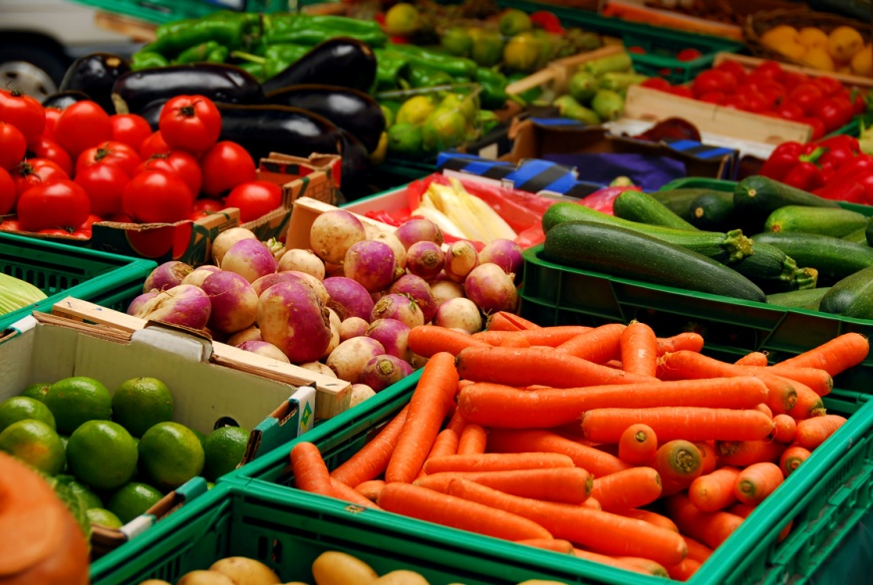
Questions?
Stephanie Singleton
Email: stephanie.singleton@sdcounty.ca.gov
Phone: (858)505-6796
LeAnh Irish
Email: le-anh.irish@sdcounty.ca.gov
Phone: (858)505-6832

