Slide 1
Garden to Cafeteria Workshop
January 13, 2012
GARDEN TO CAFETERIA: The School Wellness Connection
Deirdre Kleske
Health Educator

Slide 2
Local School Wellness Policy (LSWP)
Federally mandated for districts participating in the National School Lunch or Breakfast Program
Policy was required to be in place by start of school in 2007
Requires certain components and a plan for measuring effectiveness

Slide 3
Why a Healthy School Environment?
Healthy, fit students have better attendance and perform better academically
CA Dept. of Education study of 954,000 students, Grades 5, 7, 9 showed:
Higher academic achievement is associated with higher levels of fitness
There is a strong relationship between fitness, reading, and math scores

Slide 4
Childhood Obesity Epidemic
Countywide, 41 percent of students in grades 5th, 7th and 9th graders are considered overweight or obese.¹
1 in 3 children born in 2000 (1 in 2 Hispanic children) will develop diabetes if the obesity trend continues.
Obesity risks also include cancer, depression, high cholesterol, asthma and heart disease.
¹California Physical Fitness Report 2010-2011

Slide 5
What Does LSWP Do?
LSWP must include goals for:
Nutrition Education
Physical Education & Physical Activity
All Foods and Beverages available on campus
School-based activities designed to promote student wellness
Measurement and reporting on progress meeting goals
Notes:
Have participants pull out their district wellness policy

Slide 6
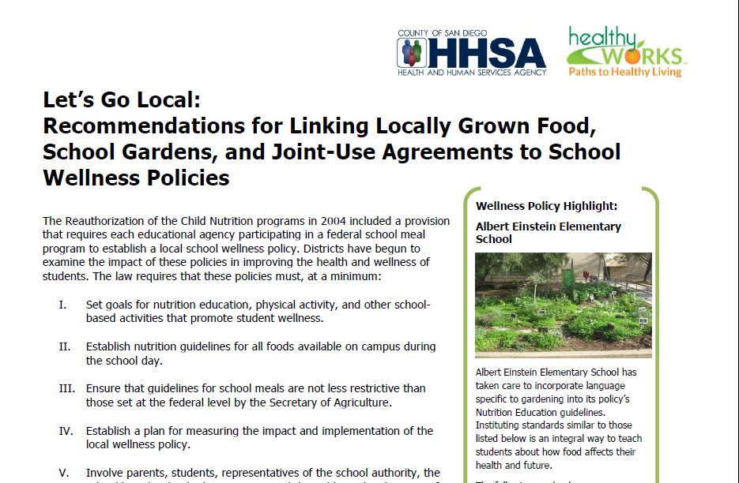
Let’s Go Local!
Recommendations for Linking Locally
Grown Food, School Gardens, and Joint-Use Agreements
Notes:
Ask a volunteer to read a paragraph concerning this topic. If more than one paragraph ask for another volunteer. Prizes may be given to encourage volunteers.

Slide 7
Garden To Cafeteria
Is it allowed?
There is no provision in the National School Lunch Program or other federal law that prevents school cafeterias from using school garden produce.
The model Food Law, upon which most state retail food laws are patterned, does not prohibit school cafeterias from utilizing produce grown in a school garden.
Consistent with this, school garden to cafeteria programs in California do not conflict with the California Retail Food Code.
National Policy and Legal Analysis Network to Prevent Childhood Obesity (NPLAN)
Notes:
Have participants pull out their district wellness policy

Slide 8
Garden To Cafeteria
Is it encouraged?
The Healthy, Hunger Free Kids Act
Federal legislation governing nutrition standards
Will require more fruits & vegetables and local sourcing of food.
Will provide competitive grants and technical assistance to schools to implement farm to school programs, including developing school gardens.

Slide 9
Resources
NFSM (National Food Service Management
Institute)
Produce safety resources & videos on receiving, preparing and storing fresh produce
Power Point on School Garden Produce Safety
http://www.nfsmi.org
(Type “produce safety” in search box)

Slide 10
Resources
NPLAN (National Policy and Legal Analysis
Network to Prevent Childhood Obesity)
Letter detailing allowability of garden produce in school cafeterias
http://www.nplanonline.org/
(Type “garden to cafeteria” in search box)

Slide 11
Contact Information
Deirdre Kleske
619-723-6457
dkleske@yahoo.com
www.californiaprojectlean.org

